Slide 1
React Components and Props

Slide 2
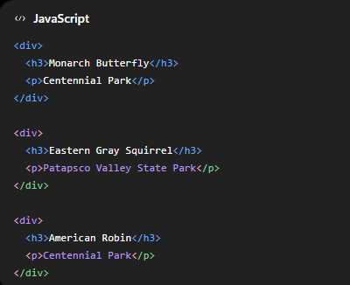

Why do we need components?
Suppose we have three observations.
We could write:
It works, but imagine you have 500 observations. Will you repeat 500 times?
Instead, React let us create a reusable component:

Slide 3
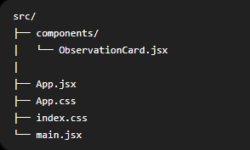

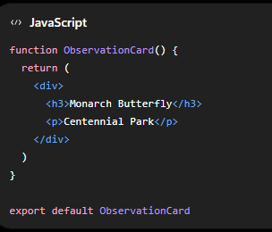
Create our first separate component
Inside “src” folder, create a new folder:
Click to open
And enter:
We just created another React component.

Slide 4

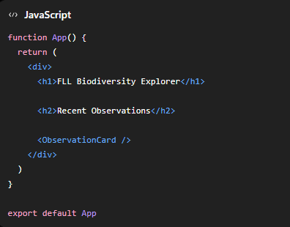
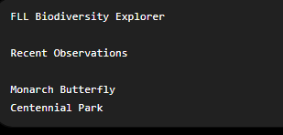
Use the component in App.jsx
Now open App.jsx.
At the top, import the component:
Then use it:
The browser should display:
React recognize it as the component we created

Slide 5
But there’s a problem
The component ObservationCard just represent one specie.
That’s not very useful
We want to have an ObservationCard to represent different species.
That’s where props come in.

Slide 6
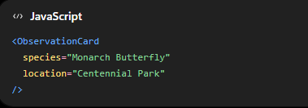

What are props?
Props are information that we give to a component. For example:
We’re giving the component two pieces of information:
These are called props, short for properties.
You can think of them like function arguments.

Slide 7
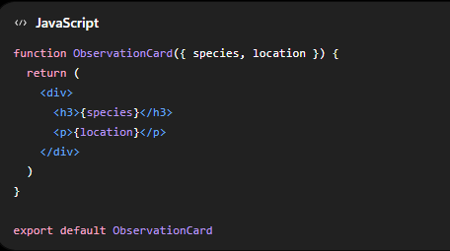
Receive the props
Now change ObservationCard.jsx to:
The component receives species and location.
The { } tells JSX:
Evaluate this as Javascript rather than displaying the word “species” or “location”.

Slide 8
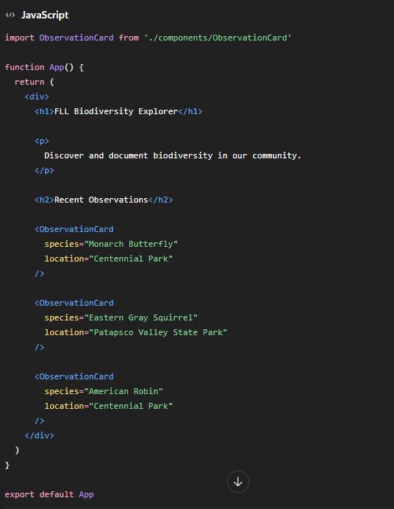
Now reuse the component
Change App.jsx to :

Slide 9
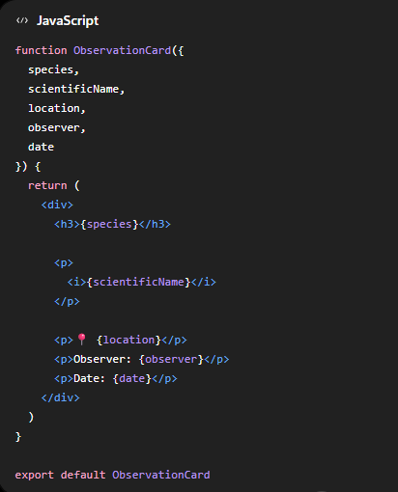
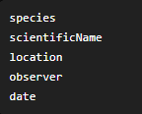
Let’s add more props
Real biodiversity observations need more information. Let’s add:
Change ObservationCard.jsx to:

Slide 10
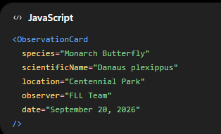
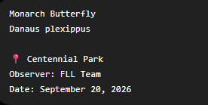
Now in App.jsx:
The page should show something like:

Slide 11




Props don’t have to be text
Props can contain numbers:
They can contain Boolean values:
Arrays:
or entire Javascript objects:

Slide 12
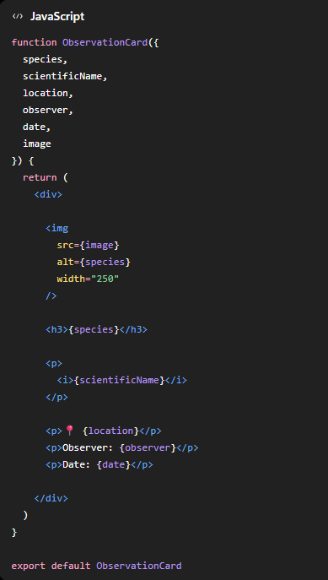

Add an observation photo
Let’s add another prop:
Change ObservationCard.jsx

Slide 13
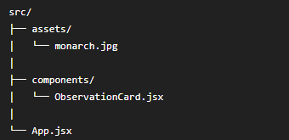

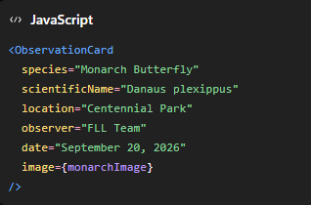
Use a local photo
Find a picture of monarch butterfly from internet and download. Name it “monarch.jpg” and save the image file to src/assets folder:
Then in App.jsx:
And:

Slide 14
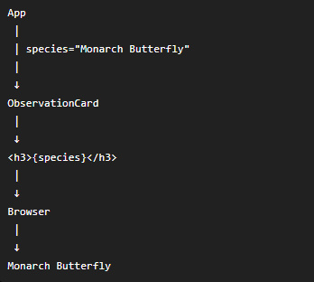
Understanding the data flow
The data starts in App.jsx. React passes the information down:
This is often called passing down to a child component. App is the parent. ObservationCard is the child.

Slide 15


Summary
What is a component?
  A reusable piece of the user interface
Why use components?
  We avoid duplicating code and can organize a complicated application into smaller pieces.
What are props?
  Information passed from one component to another.
What does this do?
  It creates an ObservationCard
  And passes “Monarch Butterfly” into its species prop.
What do { } mean in JSX?
  It let us insert value of props.

